Slide 1

Understanding Our AI Options
Zero-Shot Learning with Structured Prompting
Retrieval-Augmented Generation (RAG)
The AI generates test scenarios based on general understanding, guided by structured prompts and formatting rules without seeing our completed test scenarios.
The AI searches a dedicated knowledge base of our existing documentation and past test cases before generating more informed test scenarios.
Prompt Fine-Tuned with Few-Shot Examples
LLM Fine-Tuning
We provide 5-10 high-quality examples of exactly what we want, allowing the AI to learn our specific style and format.
A more intensive process where we train the core AI model with thousands of our existing test cases, making it an expert in our domain.

Slide 2
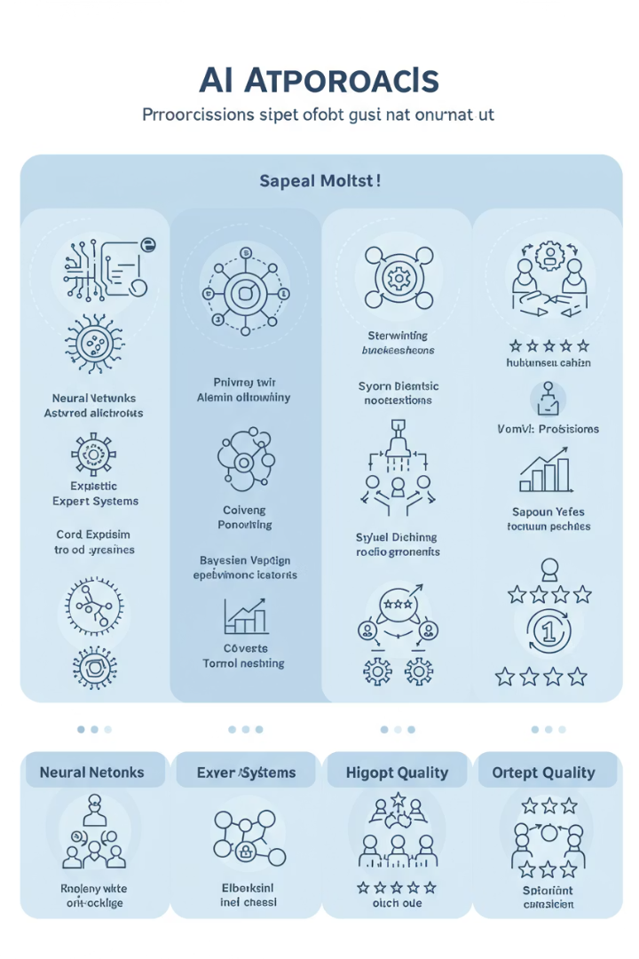
Comparing the Approaches
Feature
Zero-Shot (Instructed Generalist)
RAG (Researcher)
Few-Shot (Guided Apprentice)
LLM Fine-Tuning (Specialist)
Data Needed
Structured Prompts/Rules
Existing Knowledge Base
Small set of good examples
Large, specific dataset
Effort to Implement
Low
Medium
Medium
High
Customization Level
Low-Medium
Medium
Medium-High
Very High
Output Relevance
General, but consistent
Context-Aware
Specifically Styled
Highly Tailored & Precise
Time to Value
Immediate
Quick (if K.B. exists)
Relatively Quick
Longer Term
Our Focus
Baseline Exploration
Potential Enhancement
MVP
Post-MVP

Slide 3
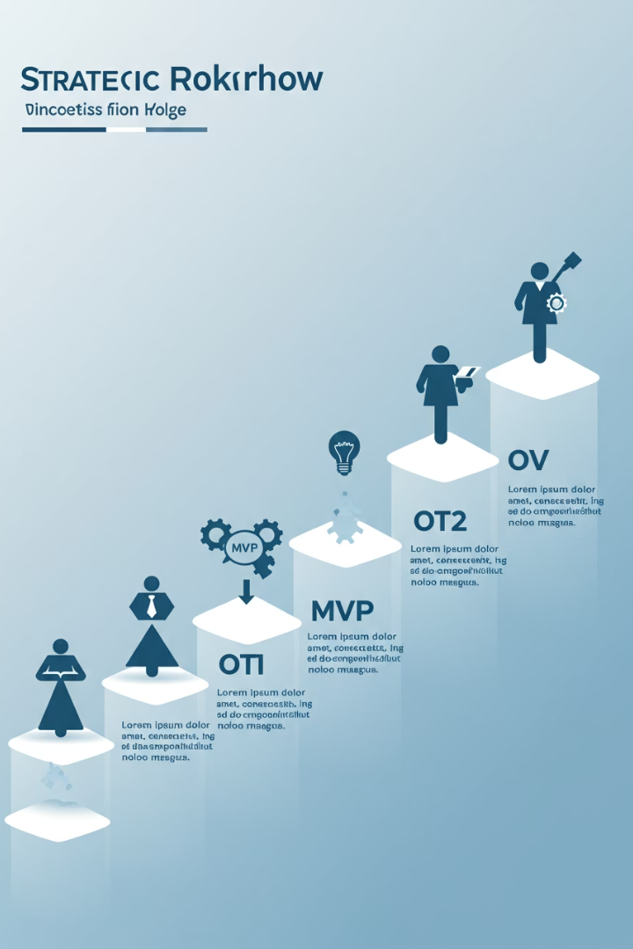




Our Strategic Phased Approach
MVP: Few-Shot Examples
Quickly achieve relevant, higher-quality test scenarios by guiding the AI with our best examples. Demonstrates value with manageable investment.
Learning & Iteration
Gather data on performance, refine our approach, and collect more examples to improve quality.
Post-MVP: LLM Fine-Tuning
Build a deeply specialized "in-house expert" as we gather more data. Provides highest accuracy and scenarios perfectly aligned with our unique needs.
Long-Term Impact
Maximize efficiency and quality with a fully optimized AI system tailored to our specific requirements.

Slide 4
Why "Few-Shot Examples" for Our MVP?
Advantages vs. Zero-Shot Learning
Advantages vs. RAG
Superior output quality & specificity by learning our specific style
Lower initial infrastructure & setup overhead
Simpler implementation & faster time-to-value
More intuitive & direct guidance through examples
More controlled & potentially lower prompt costs for MVP
Reduced ambiguity & quicker learning with concrete examples
Few-Shot offers the best balance of quality, speed, and resource efficiency to rapidly demonstrate value. It allows us to start smart and build momentum while preparing for more advanced implementations.

Slide 5






Understanding Fine-Tuning
Customized AI "Brain"
Specialized for our exact needs
Adjusted "Weights"
Millions of tiny "knobs" tuned to our data
Our Company Data
Test cases, technical documents, preferred styles
Think of an AI model as a complex brain with millions of tiny adjustment points or "knobs" called weights. Each weight controls how the model "thinks"—understanding words, connecting ideas, forming responses.
Fine-tuning tweaks those "knobs" using our company's specific data. The model learns our way of doing things, resulting in more accurate responses that use our terminology and follow our style, often with shorter instructions.

Slide 6

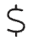



The Strategic Advantage of LLM Fine-Tuning
Significant Cost Savings
Model learns patterns, requiring shorter prompts = lower cost per request
Increased Team Productivity
More accurate, consistent outputs = less time editing or re-prompting
Efficient High-Volume Scaling
Trained once, serves thousands of requests consistently = reduced support costs
Reduced Infrastructure Complexity
Can internalize knowledge, potentially reducing need for separate RAG systems
LLM Fine-Tuning is our ambition for maximizing long-term efficiency, quality, and cost-effectiveness. It delivers superior accuracy and reliability with highly domain-specific outputs, resulting in fewer errors, better automation, and greater trust.

Slide 7
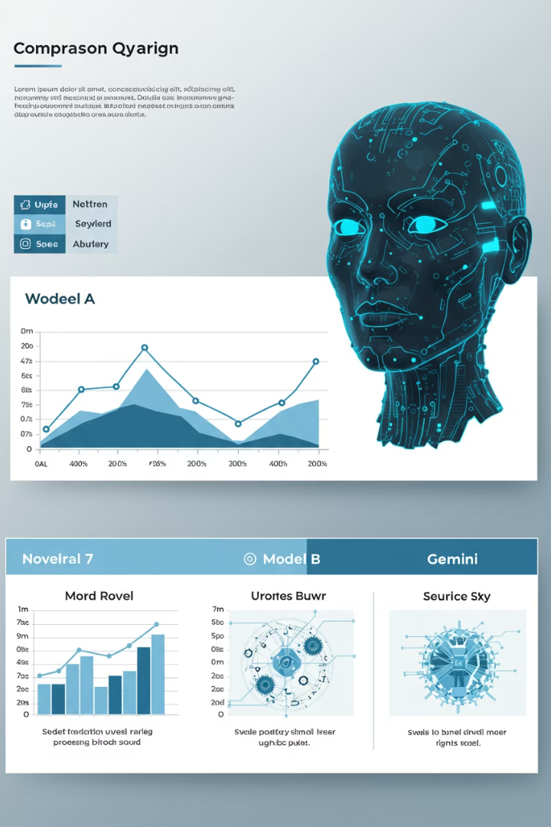
Choosing Our AI Engine: Why Google's Gemini?
1-2M
Max Context Window
Tokens processed vs. 128K-1M for competitors
99%
Long Context Recall
At 1M tokens (Gemini 1.5 Pro)
~64%
Coding Benchmark
SWE-Bench score with agentic tools
$1.25-2.50
API Cost
Per 1M tokens (Gemini 2.5 Pro preview)
Gemini excels in exceptional long-context processing, advanced reasoning, strong coding aptitude, and cost-effectiveness. Its ability to digest extensive project documentation thoroughly (with ~99% recall in tests at 1M tokens) makes it ideal for our test scenario generation needs.

Slide 8
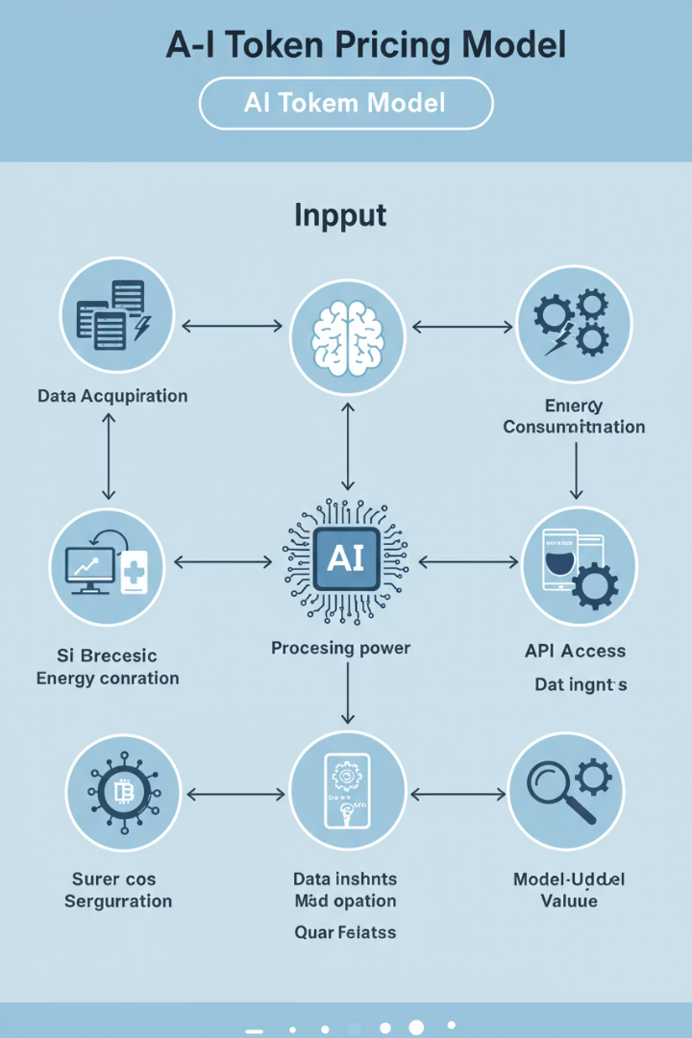
Understanding AI Costs: Tokens and Expenses
What is an AI "Token"?
Think of tokens as "word pieces" or small chunks of text. Roughly 100 tokens ≈ 75 English words. AI processes instructions (input) and generates responses (output) using tokens.
How AI Pricing Works
Cost is based on total tokens processed (input + output). Input tokens include your instructions and any documents provided. Output tokens are the AI's generated response. Prices vary by AI model.
Illustrative Example
For a 5-page PDF (approx. 5,000 input tokens) generating test scenarios (approx. 1,500 output tokens), the total cost would be approximately $0.022 per operation. Scaling to 10,000 similar operations would cost around $220.

Slide 9







Key Takeaways and Next Steps
Start Smart with Few-Shot
Measure & Learn
Begin with our MVP using Few-Shot examples for quick value
Gather performance data and refine our approach
Scale with Fine-Tuning
Build Our Dataset
Implement LLM Fine-Tuning for maximum long-term value
3
Collect and organize high-quality examples
Our phased approach allows us to demonstrate value quickly while building toward a deeply specialized AI solution. By starting with Few-Shot examples and progressing to LLM Fine-Tuning, we'll create a powerful tool that enhances our test scenario generation with increasing efficiency and accuracy.

